Slide 1
SWI-PROLOG
HOW TO USE SWI-PROLOG EDITOR

Slide 2
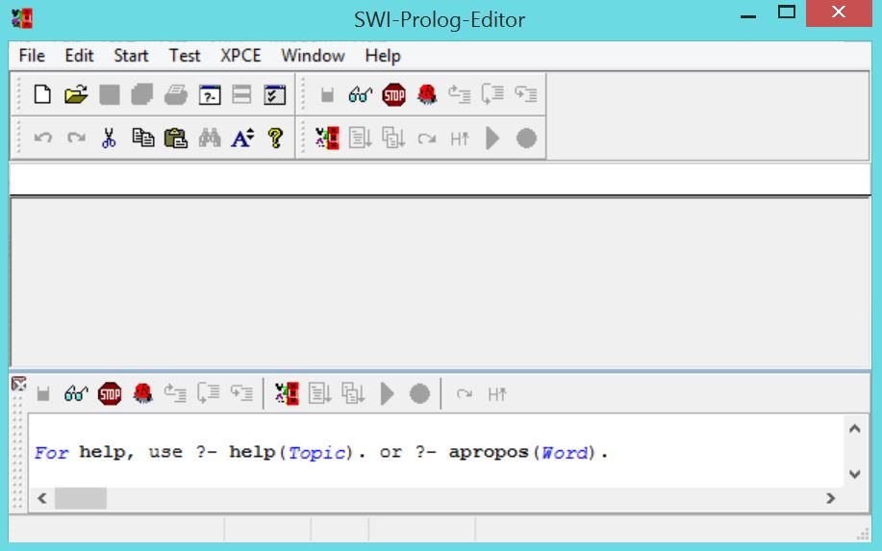
This screen is the main SWI-Prolog-Editor interface.

Slide 3
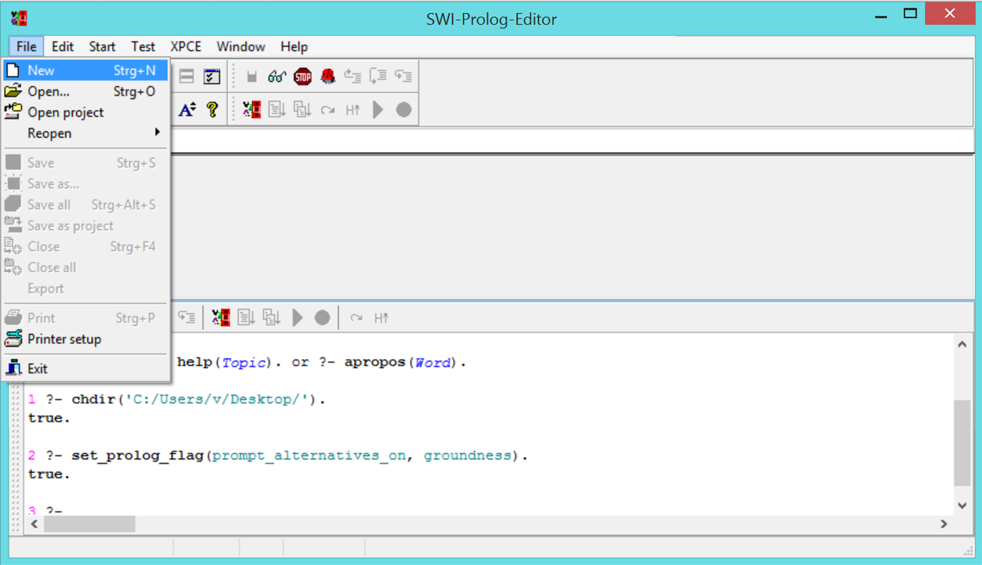
From File menu you can create new prolog file and it will directly create file with .
pl extension and default 'File1.pl' name.

Slide 4
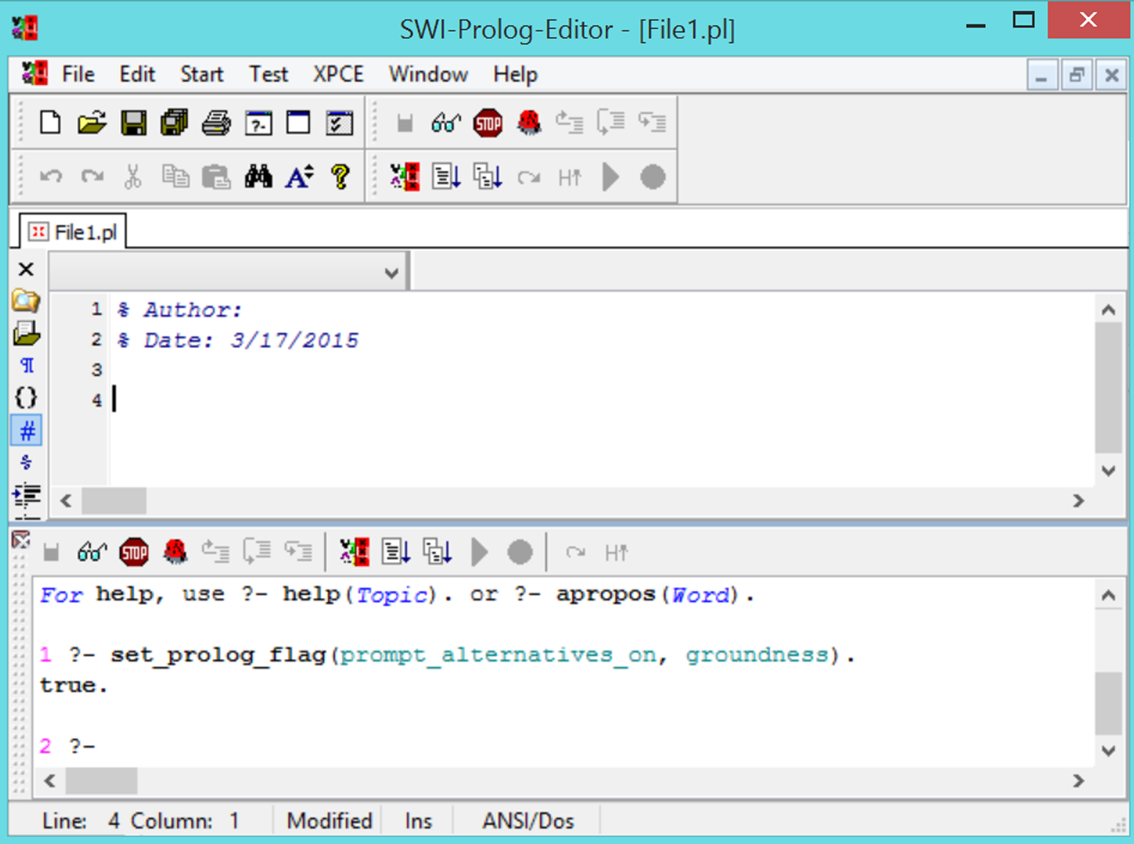
New File will be created with default File1.pl name and when you will click on save,
it will ask for the name of file and you can save it at your desired space.

Slide 5
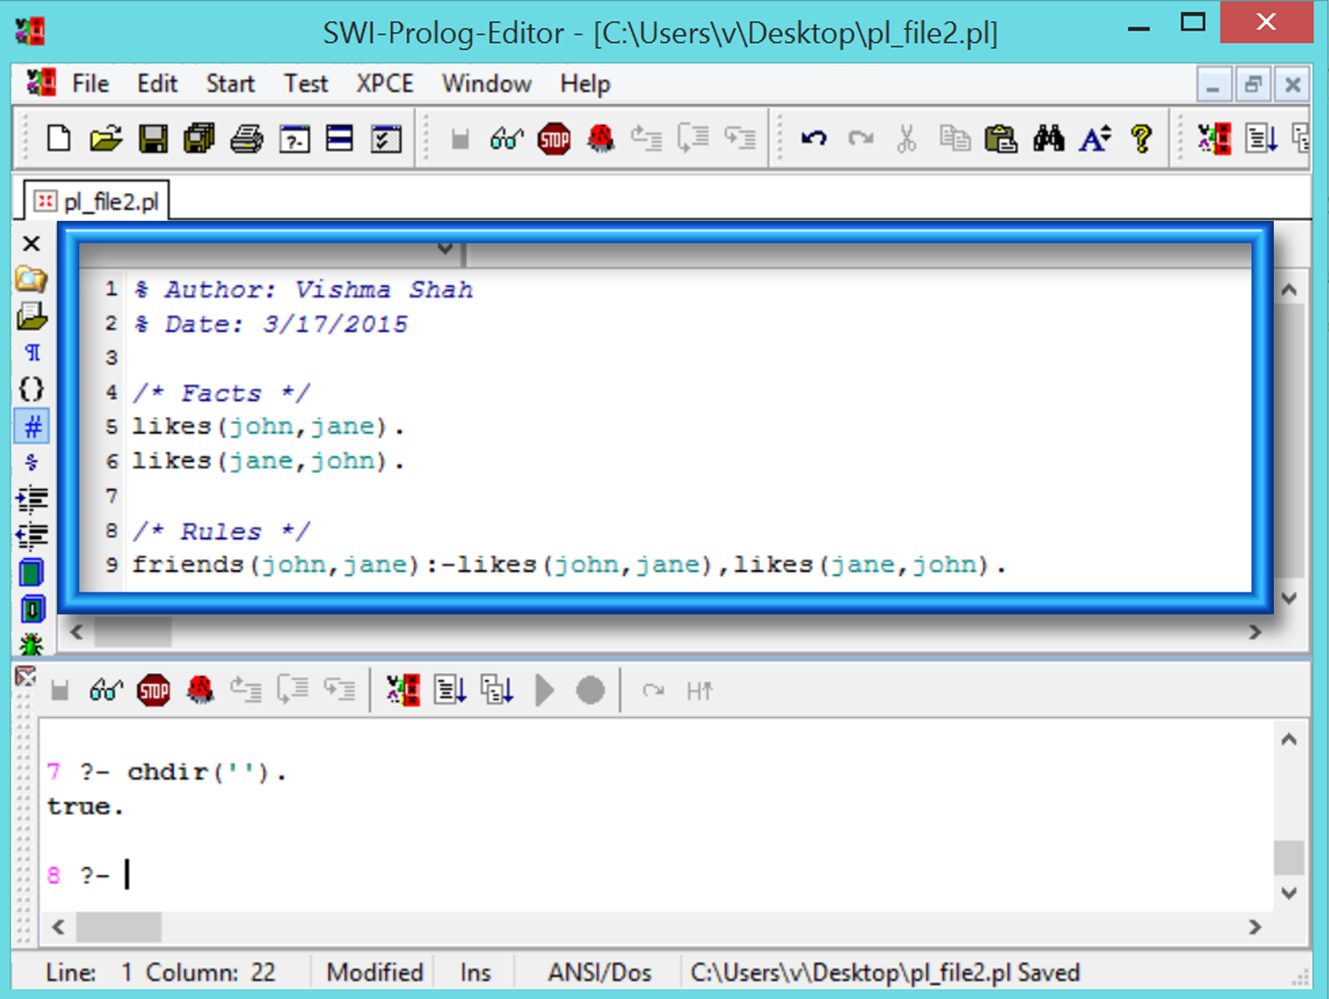
In this figure, the highlighted window is the place where you can write your prolog program

Slide 6
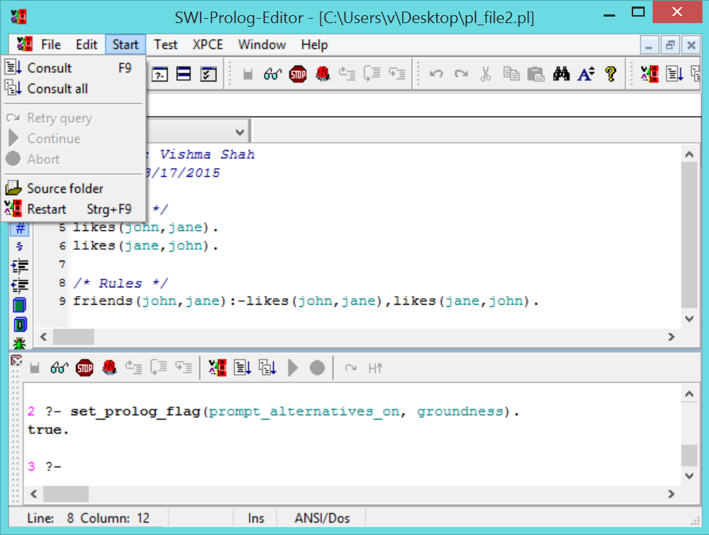
Here also you need to use Consult option before asking any query, and that option you can find from Start menu and you can load the file into prolog memory or you can directly use the short cut key F9 for Consult.
To consult multiple files you need to open desired files and click on Consult all from Start menu.

Slide 7
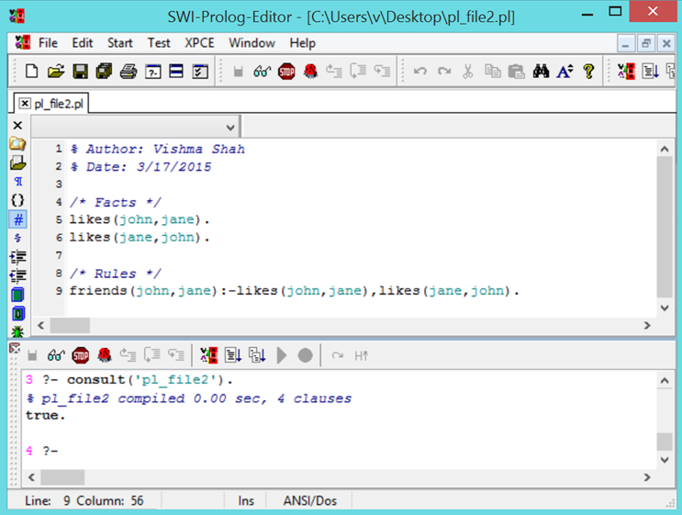
This is the interface after using Consult which shows that file has been compiled.

Slide 8
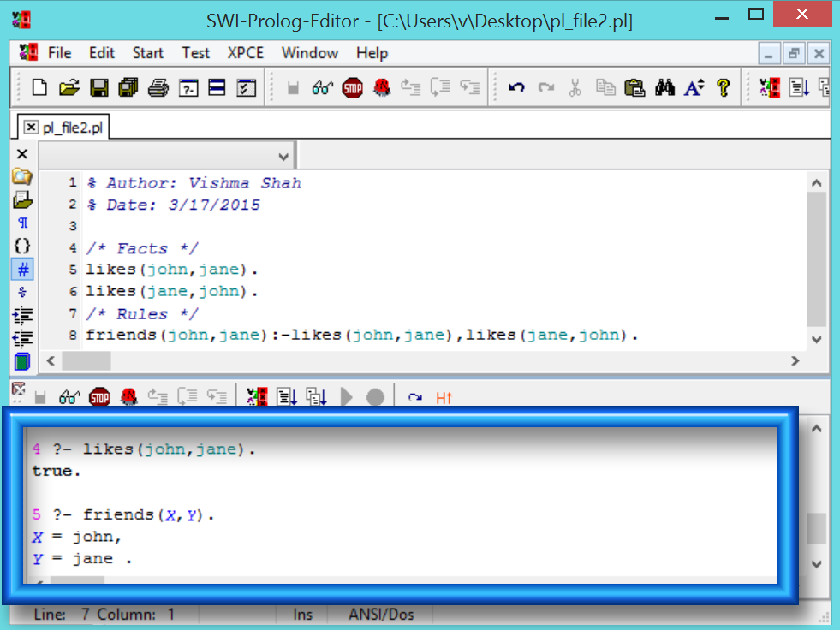
In this figure, the highlighted window is the place where you can write your queries.
Most amazing thing about this editor is, you can actually see your prolog programs in above window and you can ask queries in below window

Slide 9
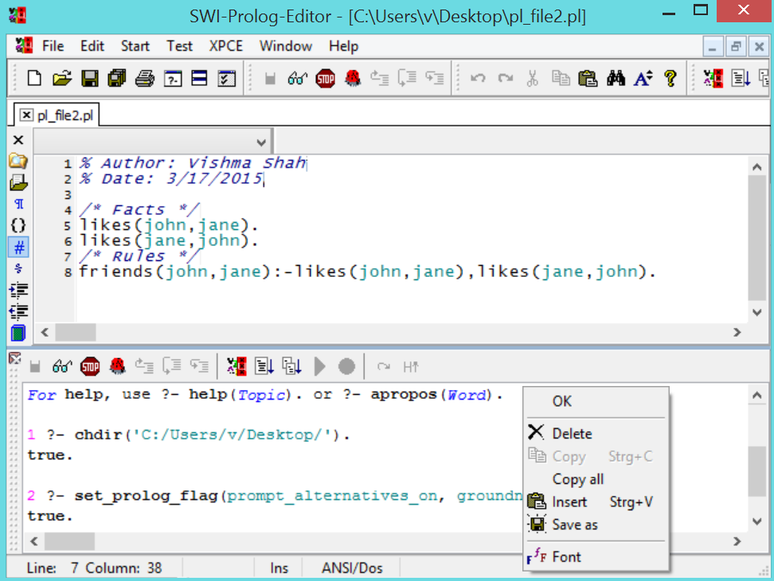
While learning the Prolog you can also enjoy playing with the editor, choosing your desired fonts,
as you can see in this figure prolog program window fonts are bit changed (though it is not advisable to do so).

